Slide 1
ELL 205 PROJECT
ANALYSING ECG USING MATLAB
Team members -
Course Co-Ordinator -
Prof. Abhishek Dixit
Ankit Raushan (2020CS10324)
Sibasish Rout (2020CS10386)
Vaibhav Saha (2020CS10403)
Under the guidance of -
Shivam Kumar (eee212010)
Bhavya Kalani (eee212003)
1

Slide 2
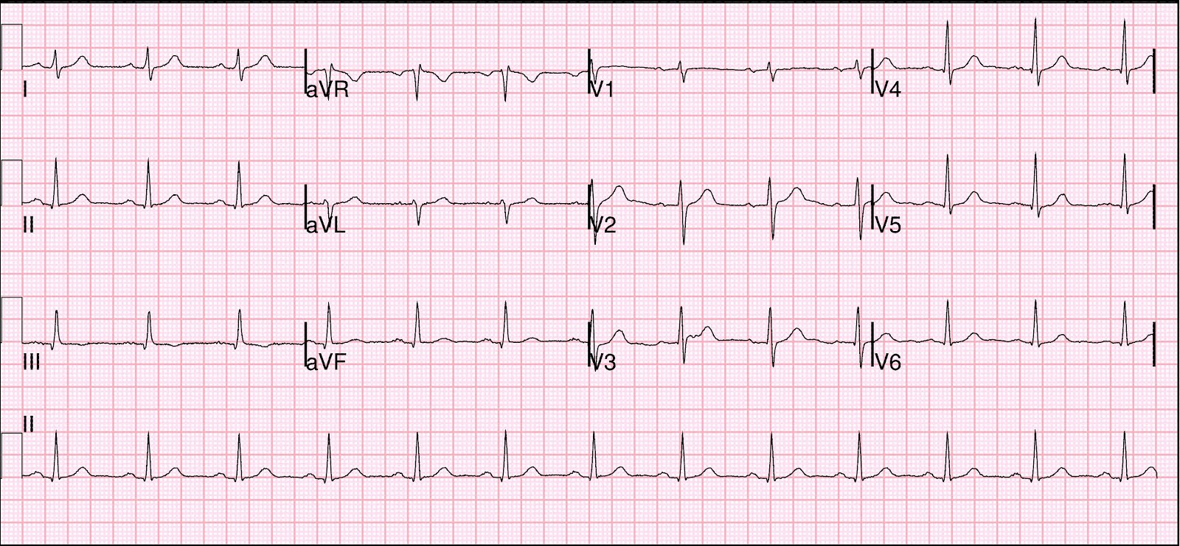
ECG
What is ECG and how is it helpful ?
ECG(electrocardiogram) is a graph of voltage versus time of the electrical activity of the heart. Electrical signals produced by our heart each time it beats is detected by an electrode placed on the skin which is recorded and plotted into graph.
The abnormalities in ECG graph helps in detecting abnormalities like –
Coronary heart diseases
Heart attack
Axes in electrogram -
X-axis (Sampling): On X-axis we plot the time
Y-axis : On Y-axis we plot the Electrical Activity of the heart.
This Photo by Unknown Author is licensed under CC BY-NC
2

Slide 3
WORKING OF OUR PROJECT
STEP 1
Load the data into a vector and then input the sampling rate of the signal.
STEP 2
Calculating the DFT of the ECG signal using Fast Fourier Transform .
STEP 3
Smoothening of the signal by using butterworth filter , adjusting its order and cut-off frequency and the applying the same to our signal.
STEP 5
Inferring the defect in the heart from the relative number of P, QRS and T waves and calculation of beats per minute.
STEP 4
Calculation of heart beat from the smoothened signal under the assumption that for the R wave the voltage detected is greater than 1.
3

Slide 4

FAST FOURIER TRANSFORM
A fast Fourier transform (FFT) is an algorithm that computes the discrete Fourier transform (DFT) of a sequence, or its inverse (IDFT).
Fast fourier transform is one of the most widely used algorithms in the world and reduces the time complexity of the algorithm to O(n log(n)) by using matrix computations .
Fourier analysis converts a signal from its original domain (often time or space) to a representation in the frequency domain and vice versa.
4

Slide 5
SIGNAL SMOOTHENING AND THE USE OF FILTERS
Smoothing is how we discover important patterns in our data while leaving out things that are unimportant (i.e. noise). We use filtering to perform this smoothing. The goal of smoothing is to produce slow changes in value so that it's easier to see trends in our data.
A filter is a device or process that, completely or partially, suppresses unwanted components or features from a signal. This usually means removing some frequencies to suppress interfering signals and to reduce background noise.
When the signal frequency is within the filter's pass band, the filter passes the signal. As the signal moves out of the pass band, the filter begins to attenuate the signal. Note that the transition from the pass band to the stop band is a gradual process, where the filter's response decreases continuously.
5

Slide 6
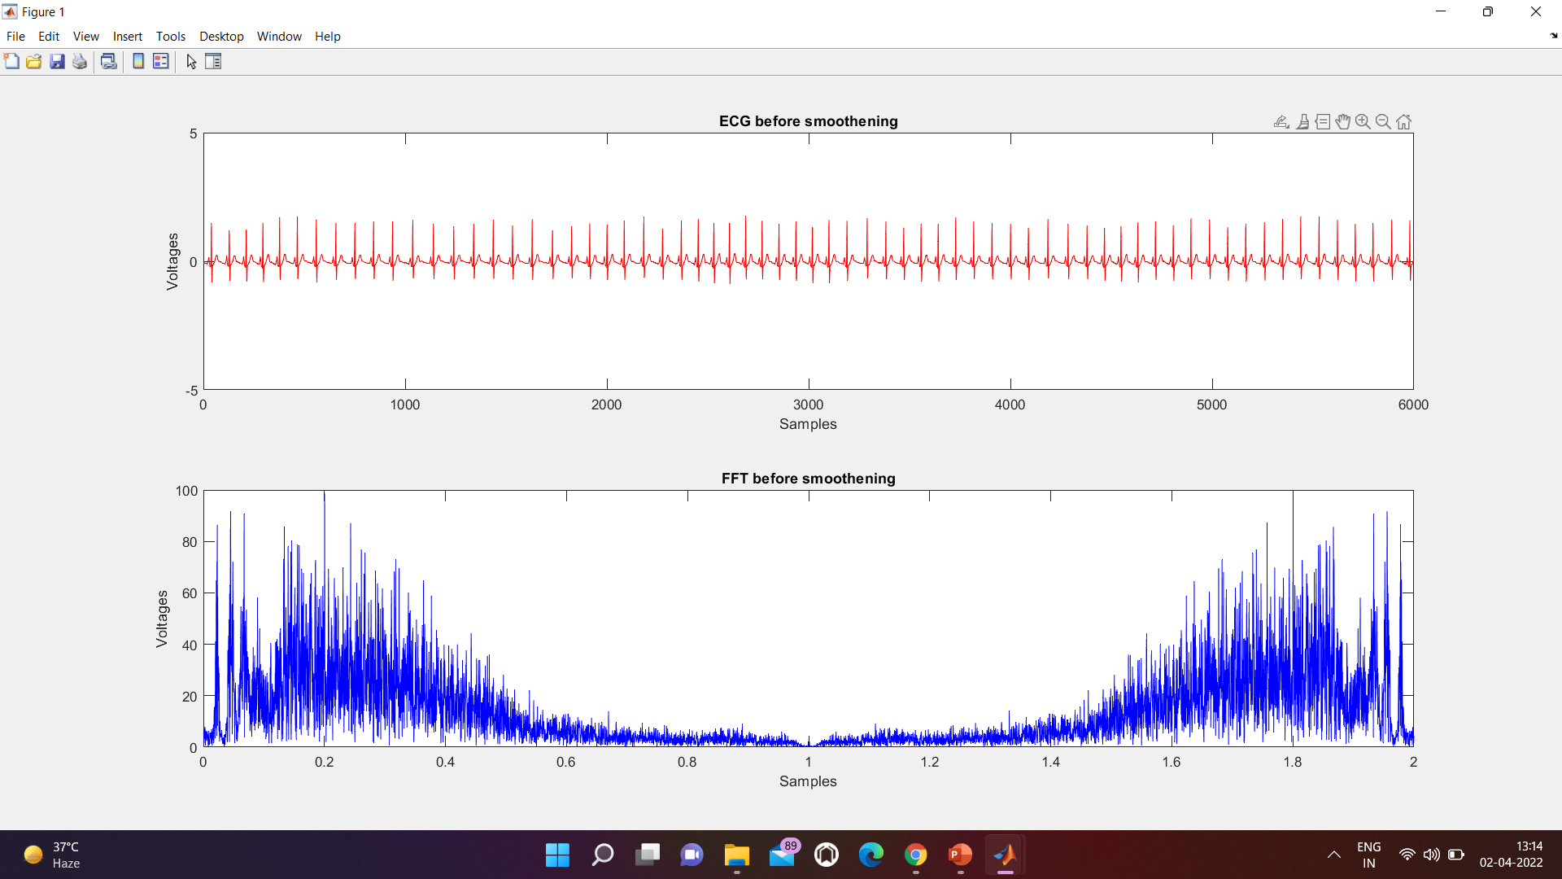
7

Slide 7
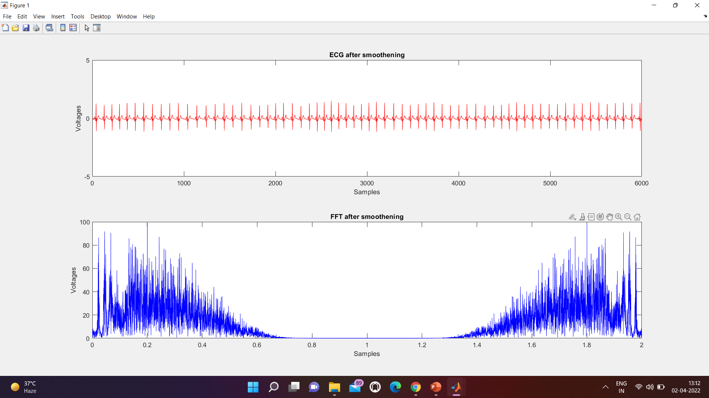
8

Slide 8
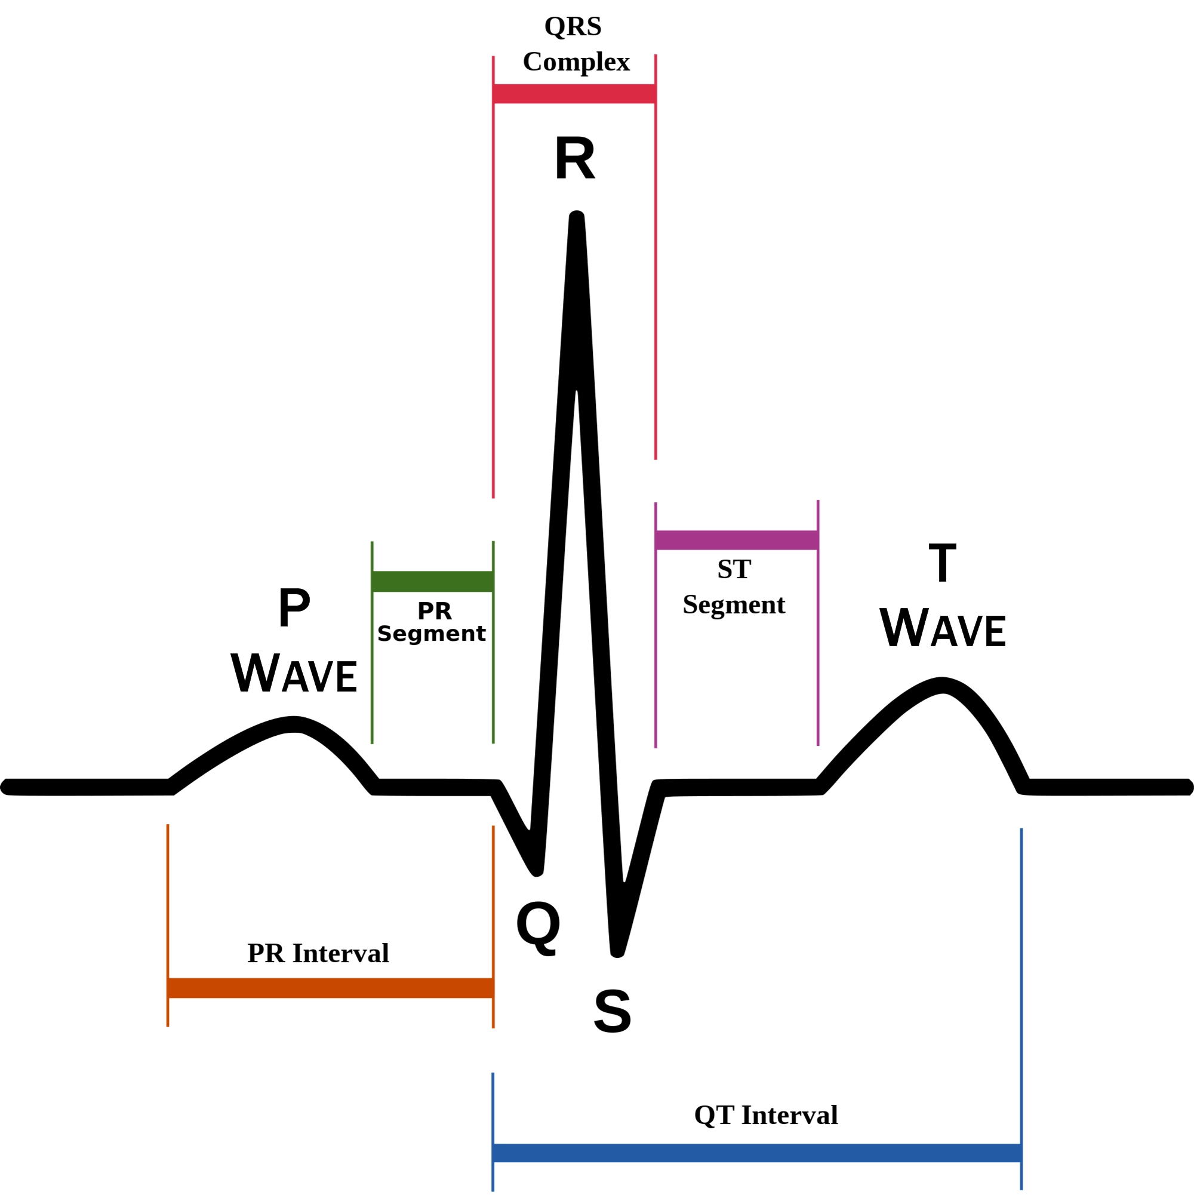
How we calculate the number of heartbeats from the ECG plot ?
Under normal circumstances the number of beats = Number of R waves = Number of Q waves = Number of S waves =Number of P waves = Number of T waves
Duration in seconds=number of samples/sampling frequency
Duration in minute=Duration in seconds/60
Beats per minute = beats/Duration in minute
This Photo by Unknown Author is licensed under CC BY-SA
8

Slide 9
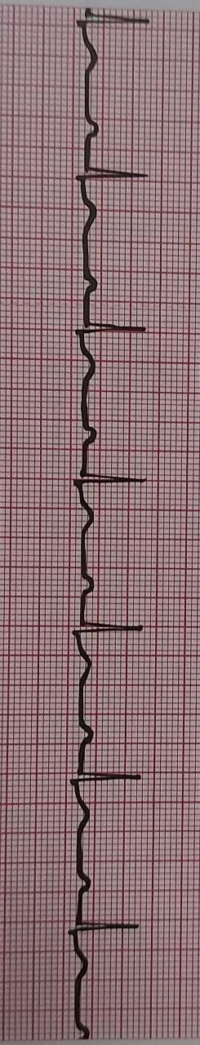
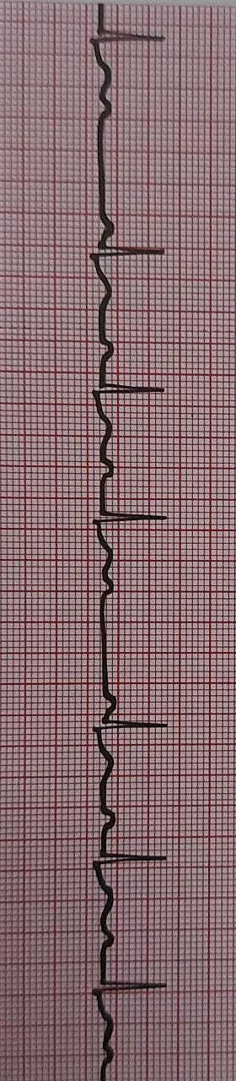
DETECTION OF DEFECTS
ECG OF A FIRST STAGE HEART BLOCK
ECG OF SECOND STAGE HEART BLOCK
9

Slide 10
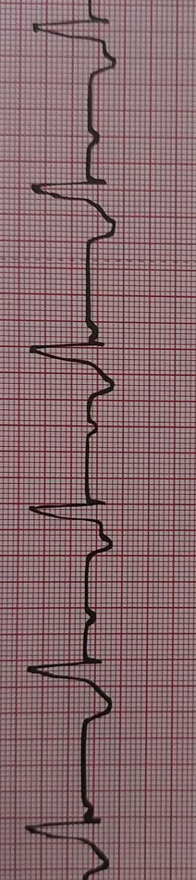
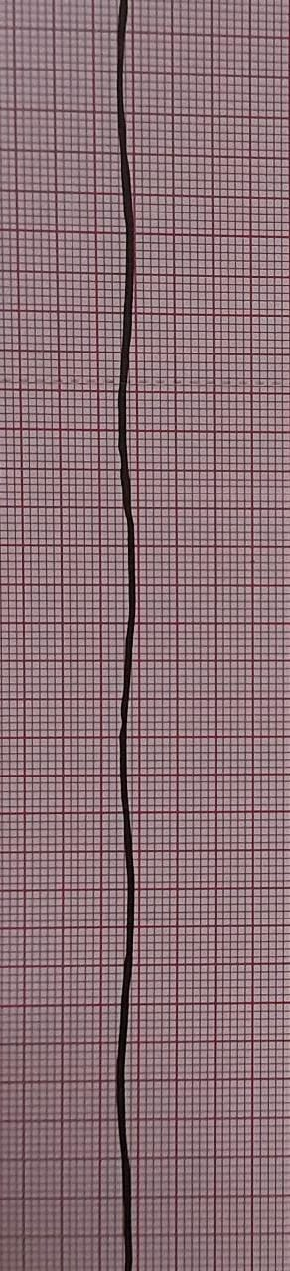
DETECTION OF DEFECTS
ECG OF THIRD STAGE HEART BLOCK
ECG OF A DEAD PERSON
10

Slide 11
REFERENCES
https://www.youtube.com/watch?v=3tdumuwHgxc
https://en.wikipedia.org/wiki/Main_Page
http://evolve.elsevier.com
https://in.mathworks.com/
ELL 205 class notes
11

Slide 12
THANK YOU!!
12

